Slide 1
Economic Foundations of Strategy
Chapter 3: Property Rights Theory
Joe Mahoney
University of Illinois at Urbana-Champaign

Slide 2
Property Rights THEORY
1. Contracting Property Rights (Libecap, 1989)
2. Institutions, Institutional Change, and Economic Performance (North, 1990)
3. An Economic Analysis of Property Rights (Barzel, 1989)
4. Economic Behavior and Institutions (Eggertsson, 1990)
5. Firms, Contracts, and Financial Structure (Hart, 1995)

Slide 3
Criteria for Efficient Property Rights
Universality
All scarce resources are owned by someone
Exclusivity
Property rights are exclusive rights
Transferability
Resources can be allocated from low to high yield uses
Notes:
exclusivity of rights to choose the use of a resource
exclusivity of rights to the services of a resource
Rights to exchange the resource at mutually agreeable terms.

Slide 4
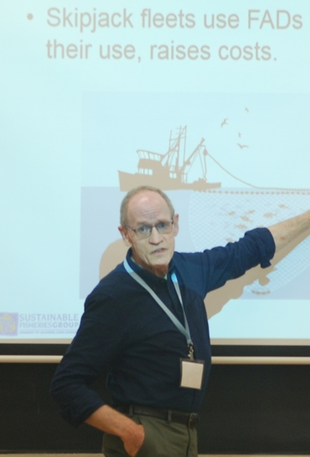
Contracting For Property Rights
Libecap 1989

Slide 5

How do institutions evolve in response to economic incentives, strategies, and choices?
Property rights provide the basic economic incentive system that shapes resource allocation.
Property rights are formed and enforced by political entities, and they reflect the conflicting economic interests and bargaining strengths of those affected.

Slide 6
Libecap defines property rights as:
“The social institutions that define or delimit the range of privileges granted to individuals of specific resources such as parcels of land or water. ”

Slide 7
What are property rights (Libecap, 1989)
The right to exclude non-owners from access;
The right to appropriate the steam of economic rents from use of and investments in the resource; and
The rights to sell or otherwise transfer the resource to others.
Notes:
This creates Private Ownership which can evolve into a variety or property rights

Slide 8
Libecap defines property rights as:
Property rights institutions range from:
Formal arrangements
Informal arrangements
(constitutional provisions, statues, and judicial rulings)
(conventions and customs regarding the allocation and uses of property)

Slide 9
Bargaining and Property Rights
Economic decision makers are hypothesized to adopt or modify property rights to mitigate economic losses of the common pool.
  Only if: Private benefits > private costs
        Davis and North (1971)
“The fact that growth has been more exceptional than stagnation or decline suggest that efficient property rights are unusual in history.
        North (1981)
The positions taken by the bargaining parties (…) will be molded by their private expected gains, and by the actions of the other parties.
  Property rights institutions are determined through the political process.
Bargaining positions taken by the parties depend on how the parties view their economic welfare under new arrangement.
  They must see it improved or at least not worsened

Slide 10
Bargaining and Property Rights
Property rights institutions critically affect decision making regarding resource use and, hence, affect economic behavior and economic performance.
Property rights institutions are determined through the political process, involving either negotiations among immediate group members or lobbying activities that take place at higher levels of government.
The political process of defining and enforcing property rights can be divisive because of the distributional implications of different property rights allocations.

Slide 11


Libecap (1989): Contracting for Property Rights
Even though society would be better off with the public goods provided by new property rights (e.g., the correction of “common pool losses” such as can be found for open fisheries and oil field dissipation), the distributional implications lead influential parties to oppose institutional change.

Slide 12
The nature by which property rights are defined and enforced affects the performance of an economy due to:
Assigning ownership to valuable resources and by designating who bears the economic rewards and costs of resource-use decisions
01
Property rights institutions thus structure incentives for economic behavior in society.
Allocating decision-making authority, the prevailing property rights arrangement determines who the key actors are in the economic system
02

Slide 13
Why can happen if we don’t contract property rights?
Common pool losses more frequent
Property rights to the resource is not assured
Individuals don’t have to consider the social cost of their activities
Individuals can use the resources too quickly
Competitive pressure encourages short-term horizons in production
There is a reduced incentive to invest
Resource value decreases
Exchange and relocation to higher valued uses is more costly and less effective
Asset processes are needed to understand the underpinning demand and supply conditions

Slide 14



Libecap’s analytical framework
Property rights can emerge from three factors:
Shifts in relative prices
Changes in production and enforcement technology
Shifts in preferences and other political parameters

Slide 15
Libecap’s analytical framework
1
2
3
4
5
All else being equal, the greater the size of the anticipated aggregate economic benefits of institutional change the more likely new property rights will be sought and adopted.
The larger the number of competing interest groups, the more likely distributional conflicts will block or delay institutional change.
The greater the heterogeneity of competing interest groups, the more likely distributional conflicts will block or delay institutional change.
Distributional conflicts will be intensified if there are known serious information asymmetries among competing parties regarding the evaluation of individual claims.
The greater the concentration of wealth under the proposed property right, the greater likelihood of political opposition and the less likely institutional change without modification by politicians.

Slide 16

contracting FOR THE UNITIZATION OF OIL FIELDS
LIBECAP 1989

Slide 17

UNITIZATION OF OIL FIELDS
Contrary to the optimistic assertions of Chicago School economists, the failure of oil field unitization in Oklahoma and Texas, despite well-recognized and significant aggregate economic gains from unitizing oil production, is an exemplar of how asymmetric information and distributional conflicts over rental shares can limit the adoption of property rights to reduce common pool losses.
  To assert that property rights will evolve to achieve efficiency seems to gloss over much of the impediments that can block institutional change in under-developed countries.

Slide 18
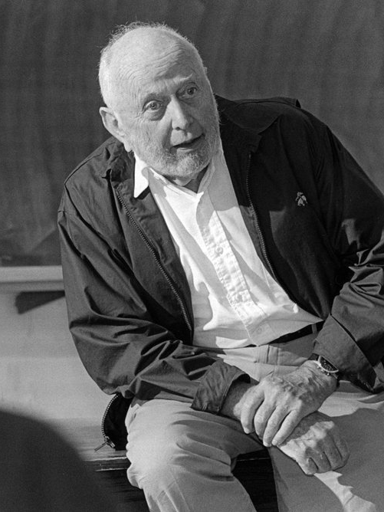
Institutions, institutional change, and economic performance
North, 1990

Slide 19
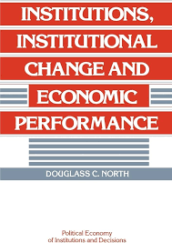
North’s context
North (1990) abandoned his optimistic view about the evolution of property rights towards economic value creation (Davis & North, 1971).
North (1990) maintains that the persistence of inefficient property rights regime explain why the whole world is not economically developed
  Rulers devise property rights in their own economic interests and positive transaction costs result in the persistence of inefficient property rights.
  The coercive power of the state has been employed throughout most of history in ways that have stymied economic growth.

Slide 20

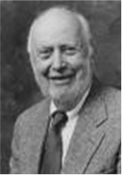
North (1990): Institutions, Institutional Change and Economic Performance
The inability of societies to develop effective, low-cost enforcement of contracts is the most important source of both historical stagnation and contemporary underdevelopment in the third world.
Enforcement in the third world economies is uncertain not only because of ambiguity of legal doctrine (a measurement cost) but also because of uncertainty with respect to the behavior of the judicial system.

Slide 21
Today’s decisions and tomorrow’s choices are shaped by the past
History matters not just because we can learn from the past but also because the present and the future are connected to the past by the continuity of society’s institutions.
North wants to provide an analytical framework to integrate institutional analysis into economics and economic history while understanding historical change.

Slide 22
What are institutions? (north, 1990)
Institutions are any constraint humans devise to shape their interactions and organizations, created to take advantage of the opportunities presented by institutions in shaping the development of economies
  Institutions reduce uncertainty by providing structure. They define and limit the set of choices individuals can make
  Their major role in society is to reduce uncertainty by establishing a stable structure to human interactions --- even though, this structure might not always be efficient.

Slide 23
What are institutions? (north, 1990)
Institutional framework influences:
What organizations come into existence
How organizations evolve
Organizations influence how the institutional framework evolves
Organizations are groups of individuals bound by some common purpose to achieve goals. These include political bodies, educational bodies, and social bodies.

Slide 24
The role OF Actors
Actors frequently must act on incomplete information and process the information they do have through mental constructs. This may result in persistently inefficient paths.
The imperfect subjective models of the actors as they attempt to understand the complexities of the problems that they confront, which can lead to the persistence of inefficient property rights.
North (1990) maintains that it is wrong to assume that actors possess the cognitive systems that provide true models of the world.

Slide 25
North’s institutional framework
Formal Constraints
Formal rules that can complement and increase the effectiveness of informal rules.
For example: political and judicial rules, economic rules, and contracts
Enforcement
Effective judicial systems include well-specified bodies of law and agents like lawyers, arbitrators, and mediators.
Third worlds economies struggle to develop effective, low-cost enforcements of contracts, which is the most important source of historical stagnation and underdevelopment
Institutions
Need resources to define and protect property rights and to enforce agreements
These resources work to transform the inputs and output goods and services.

Slide 26
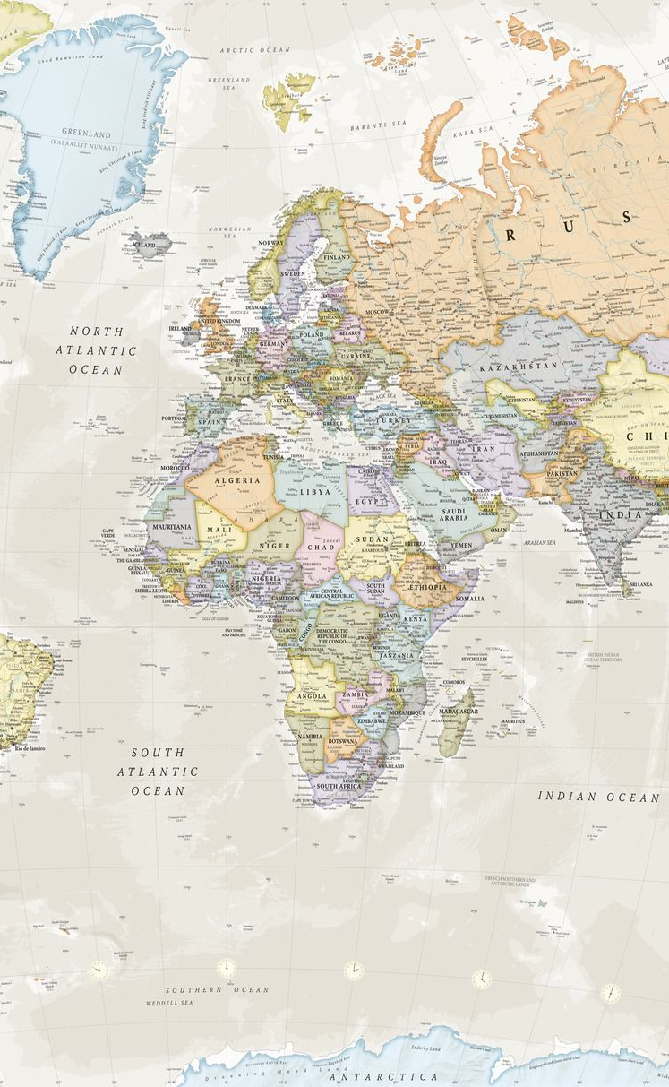
Contrasting the institutional framework
Contrasting the institutional framework in countries such as the United States, England, France, Germany and Japan with Third World countries makes clear that the institutional framework is the critical success factor of economies both cross-sectionally and through time.
The institutional framework shapes the direction of the acquisition of knowledge and capabilities, and that direction will be the decisive factor for the long-run development of that society.

Slide 27
North 1990
Path dependence is the key to an analytical understanding of long-run change in property rights.
Property rights and economic incentives are the underpinning determinants of economic performance.
One gets efficient institutions by a political entity that has built-in economic incentives to create and enforce efficient property rights.

Slide 28

AN ECONOMIC ANALYSIS OF PROPERTY RIGHTS
Barzel, 1990

Slide 29
Transaction costs (barzel, 1990)
Barzel emphasizes a particular type of transaction costs: measurement costs
It is costly to measure commodities fully, and thus the potential of wealth capture is present in every exchange.
Property rights over resources or other people are not constant, they are a function of their own direct efforts at protection from others’ capture attempts and of government protection
  It is complicated because people always expect to gain from an exchange.

Slide 30
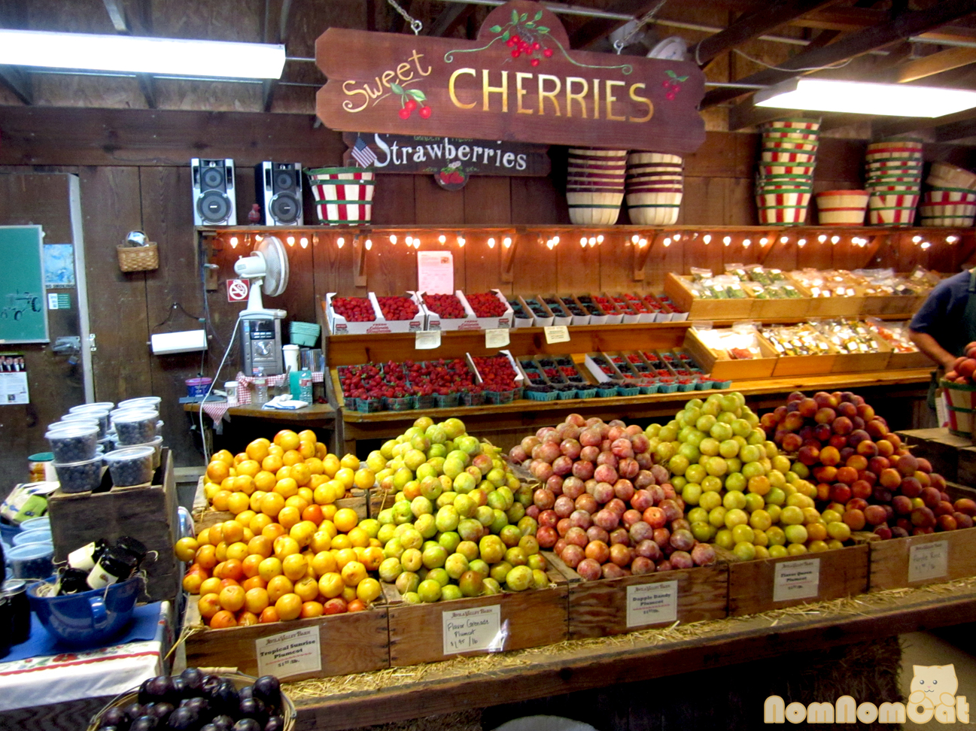
wealth capture illustrated by the phenomenon of the sale of cherries
Consider the problems of information that present themselves when cherries are exchanged.
  Customers spend resources to determine whether a store’s cherries are worth buying, and to determine which cherries to buy.
  Storeowners who allow customers to pick and choose cannot easily prevent these customers from eating cherries, nor can they prevent customers’ careless handling of cherries.
  Indeed, the process of picking and choosing itself allows wealth capture in the form of excess choosing.

Slide 31
wealth capture illustrated by the phenomenon of the sale of cherries
If information about the cherries were costless, pilfering, damage and excess choosing of cherries would be avoided.
The research literature that assumes that the economic costs of transactions are zero and that all property rights are perfectly well delineated is incapable of dealing with a vast array of actual observed practices.

Slide 32
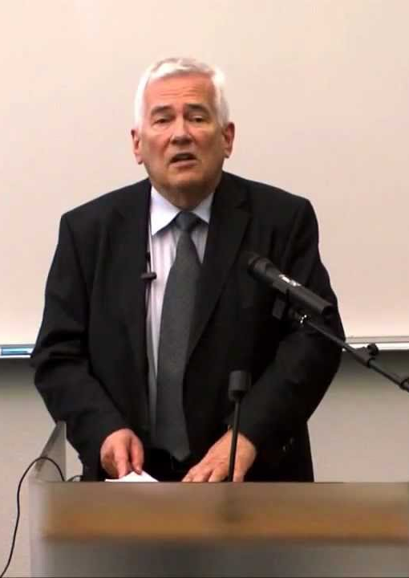
ECONOMIC behavior and institutions
Eggertsson, 1990

Slide 33
Three levels of property rights theory:
The structure of the property rights and forms of organization are explicitly modeled but are treated as exogenous.
Organization form is endogenous, but the fundamental structure of property rights remains exogenous; and
Attempts are made to consider both social and political rules, and the structure of political institutions as endogenous in a positive transaction costs world.
1
2
3

Slide 34
what ARE PROPERTY RIGHTS? (EGGERTSSON, 1990)
The right of individuals to use resources
Rights are supported by force of etiquette, social custom, ostracism, and formal laws
System of Property rights:
Is a method of assigning to individuals the authority to select, for specific goods, any use unprohibited class of uses

Slide 35

Property rights to a resource are often partitioned
LAND
PERSON A has the right to dump ashes on the land
PERSON B possess the right to grow wheat on the land
PERSON C has the right to dump ashes on the land
Person D possess the right to fly an airplane over the land

Slide 36
TRANSACTION COSTS IN PROPERTY RIGHTS
Coase (1960) Theorem
The initial partition of property rights does not matter for the allocation of resources (ignoring wealth effects) when all rights are freely transferable, and the costs of transacting are zero.
If transactions costs are not zero, the role of the State can have a crucial effect on resource allocation.
Eggertsson (1990)
Negotiation costs and other transaction costs may block the reassignment of rights, and the initial partitioning of property rights by the state may have important consequences for the output of an economy.
The Property Rights approach is not complete without a Theory of the State

Slide 37
TRANSACTION COSTS IN PROPERTY RIGHTS
Demsetz (1967)
Offers an optimistic theory of property rights
Eggertsson (1990)
Finds that “interest-group theory of property rights” as a necessary modification to the optimistic view of the evolution of property rights from the earlier literature
“Property rights develop to internalize externalities when the gains of internalization become greater than the cost of internalization” (1967: 350).

Slide 38
Economic Behavior and Institutions
Characteristic of this optimistic view, the formulation of decision making about property rights is solely in terms of private benefits and private costs. The theory does not deal with the free-riding problems that plague group decision, nor is there any attempt to model the political processes.
Maintains that one of the first steps to modify the optimistic model of property rights involves linking this model to the “interest-group theory of property rights” legislation and government.

Slide 39
Economic Behavior and Institutions
Property rights, which serve the narrow self-interest of special interest groups but cause substantial output losses to the community, are explained in terms of transaction costs, free-riding, and asymmetric information.
Concludes (along with North, 1990) that there is overwhelming historical evidence to support the proposition that States typically do not supply structures of property rights that are appropriate for placing the economy close to the technical production frontier.

Slide 40
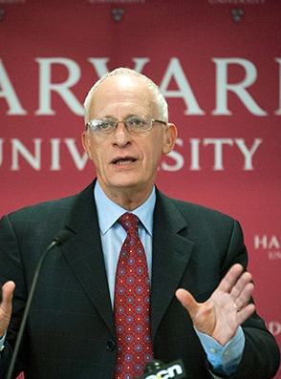
Firms, contracts, and financial structure
Hart, 1995

Slide 41
Hart’s framework
Firms arise in situations where people cannot write complete contracts and where the allocation of control is therefore important
People will write incomplete contracts so revisions and renegotiations will take place
  Because contracts are incomplete, the ex-post allocation of power (or control) matters.

Slide 42
Hart challenges Principal Agent Theory
Principal Agent Theory
It is costless to write a contract
The comprehensive contract is when the contract stipulates everyone’s obligations in every conceivable eventuality and impose large economic penalties if anybody fails to live up to the obligations
Power (the ex-post allocation of control) is irrelevant in agency theory because an optimal comprehensive contract is made and will not be renegotiated.
Modern property rights theory is closer to the incomplete contracting approach of transaction costs theory.

Slide 43
The meaning of ownership
Hart (1995) submits that it matters who has ownership of a resource
If the transaction zero, then there is no difference between renting and buying but when transaction costs are positive then there is an incentive to buy instead of renting
Machine example

Slide 44
The boundaries of the firm
Once we recognize that contracts are incomplete and transaction costs are positive, then the boundaries of the firm matter for economic efficiency.
Specifically, modern property rights theory maintains that firm boundaries are chosen to allocate the residual control rights optimally among the various parties to a transaction.

Slide 45
The source of transaction costs
Three factors missing from the standard principal-agent model:
  In a complect and unpredictable world it is difficulty for people to think far ahead to be able to plan for all the various contingencies that may arise
  Even if individual plans can be made, it is difficult for the parties to negotiate about these plans. They must find a common language that describes the states of the world
  It is difficult to write their plans down in a way that in the event of a dispute, an outside authority can figure out what these plans mean and enforce these plans

Slide 46
Economic implications of contractual incompleteness
Contractual parties may engage in a great deal of haggling over the terms of the revised contract
There may be costly legal disputes because an incomplete contract will be ambiguous
Contractual parties have asymmetric information and may fail to reach an efficient agreement

Slide 47
The property rights approach
A merger between firms with highly complementary assets enhances economic value because it reduces haggling and economic hold-up problems. (Hart (1995) provides formal modeling of transaction-cost arguments.)
The possession of power (residual control rights) is taken to be the definition of ownership in the modern property rights approach.

Slide 48
The Role of nonhuman assets
A firm’s nonhuman assets represent the glue that keeps the firm together
Nonhuman assets:
The firm’s reputation
Their distribution network
Their files containing important information
Contracts that prohibits workers from working for competitors
Example: If firm A buys firm B and there aren’t any physical assets there is nothing stopping workers from firm B to quit and make their own firm.
Helps us understand the concept of authority. Employees vs. independent contractors
The law of forbearance reinforces the authority that employers possess.

Slide 49
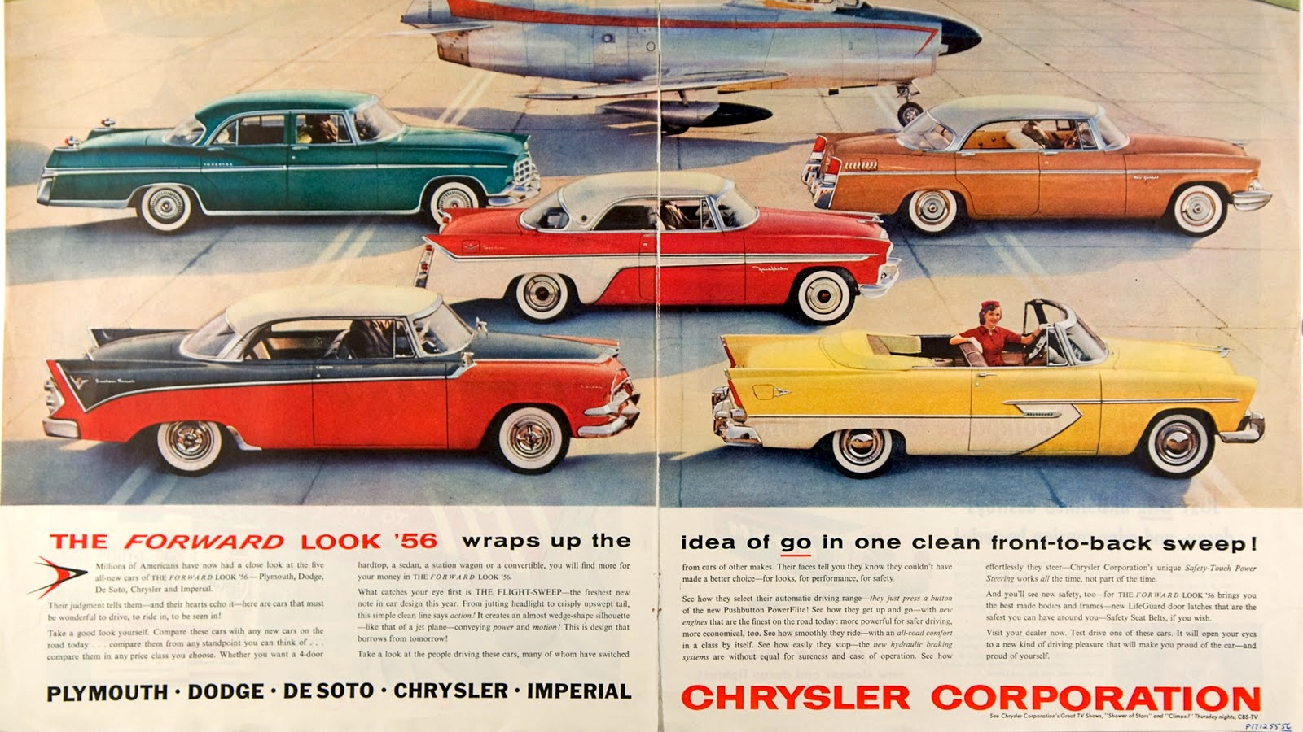
THE VERTICAL MERGER OF FISHER BODY AND GENERAL MOTORS

Slide 50
VERTICAL MERGER OF FISHER BODY AND GENERAL MOTORS
It is persuasively explained in property rights/transaction costs terms.
Reluctant to sign a short-term contract and be at the mercy of the other
Fisher Body: because of the renegotiation time
GM: hesitant to depend on one supplier
Contract negotiations became increasingly complex until in 1926 the two firms merged to mitigate bargaining difficulties.
Vertical financial ownership replaced long-term contracting, which allowed the parties to adjust in an adaptive, sequential manner. Ownership provided necessary ex post residual control rights.

